Slide 1
India-Turkey Business Council
WOMEN´S INDIAN CHAMBER OF COMMERCE AND INDUSTRY
www.wicci.in

Slide 2
Council Vision &Mission

Slide 3
Welcoming
Council Members to
WICCI
President, Vice President
and 20+ Nominated Council Members

Slide 4
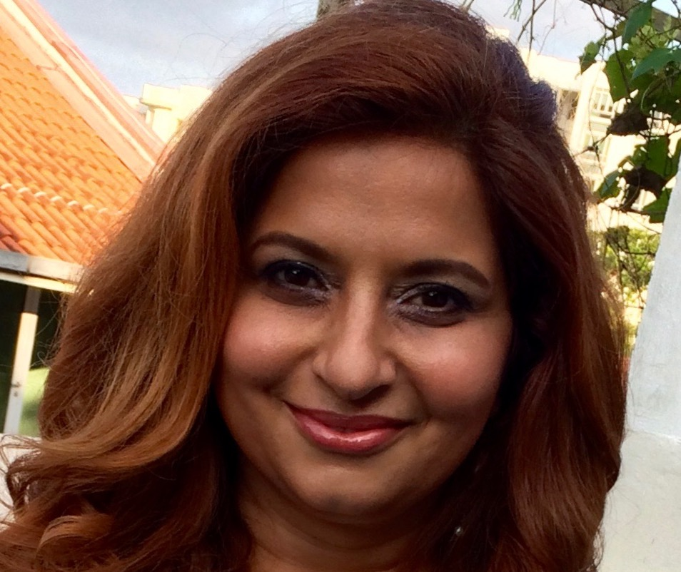
Dr. Sangeeta Sahi-President
India-Turkey Business Council WICCI
Dr. Sangeeta Sahi is the founder of Unified Human Foundation in the UK, and USA. Unified Human is a nonprofit supporting NGO projects globally, which unify human beings with Nature, and through those projects with each other. She has worked directly with NGOs in India, Africa, USA, in projects of developing innovation and natural solutions for environmental, health and cultural/community sustainability, for over 20 years.
Dr. Sangeeta, as well as working as an Integrative Medical Doctor and Anti- aging Consultant, graduating from Christian Medical College, India, also, has an MBA degree from ESSEC, Paris, France.
She is a pioneering medical physician, coming from 4 generations of medical doctors, who has been able to combine her formal medical training with a host of complementary therapies, based upon biophysical and quantum physical evidence.

Slide 5
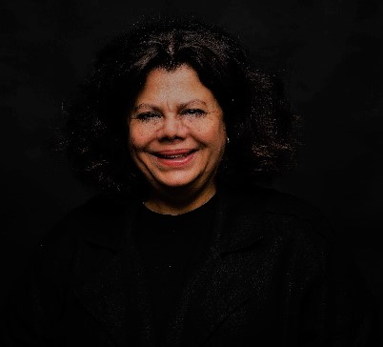
Ferda Canözer Paksoy-Vice President
India-Turkey Business Council WICCI
Ferda Paksoy graduated from Istanbul University's Law Faculty and has practiced as a lawyer since 1985, as a member of the Istanbul Bar Association.
After practiced as a lawyer rin Criminal, Commercial, Civil and Press Law arenas for 22 years she attended to a” Mediation” class of a LLM programme in Bilgi University as a”special student” on 2006-2007. By the end of this programme, she owned a scholarship to attend International Post-Graduate Course “Making and Saving the Deals” on Resolving Business Disputes Internationally, in Rome-Italy. This programme was a joint summer programme of Rome University and Hamline University with ADR Italy. She had an internship as a mediator in UNDP Rome for a month in 2007. She joined to the discussion and presentation meetings of the commision of Mediation Law for Turkey, as a representative of UBA.

Slide 6
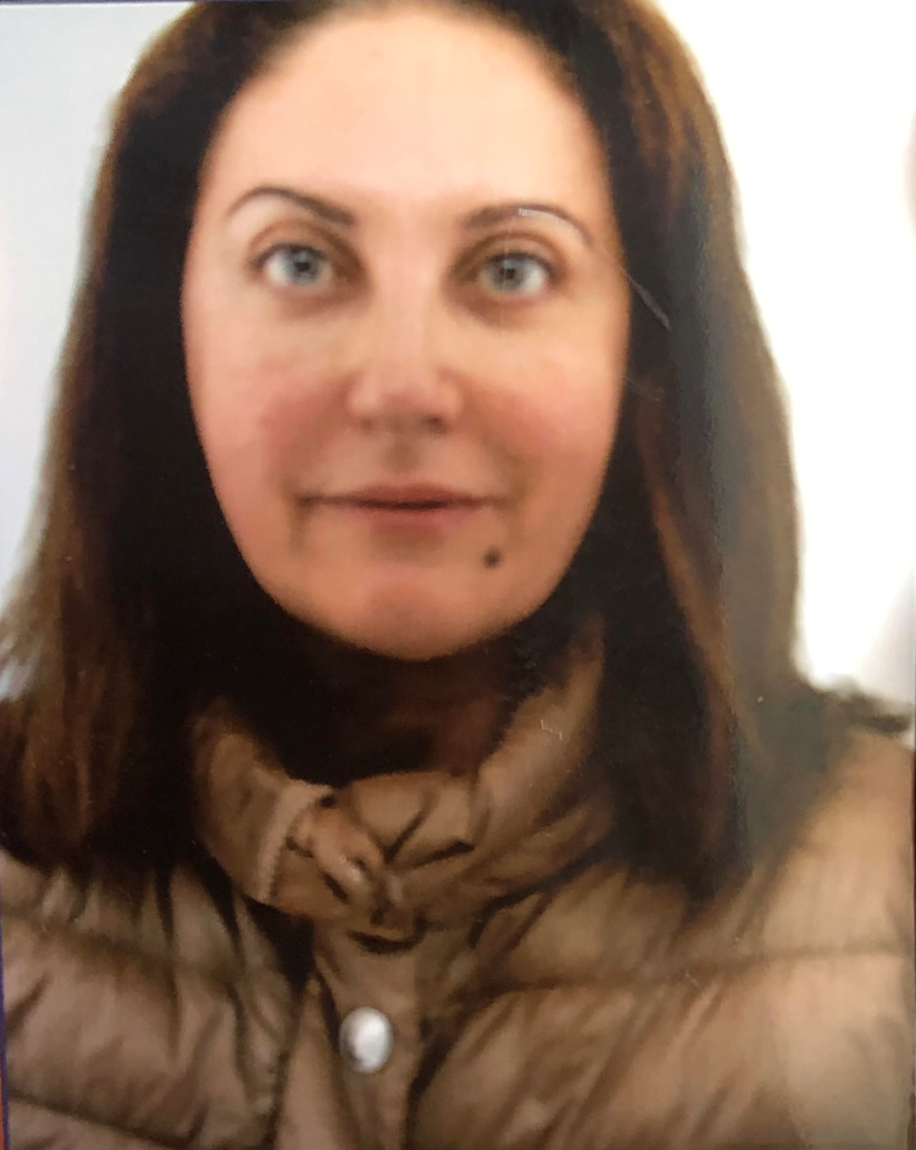
Suzan Cailliau-Council Member
India-Turkey Business Council WICCI
She was born in Baghdad in 1968 and continued her primary and secondary
education in Abu Dhabi and Jeddah, following years of childhood in Lebanon and
Syria. After returning to Turkey, she received her undergraduate degree from
Middle East Technical University (METU) Chemical Engineering Department in
1992 and MBA degree from Bilkent University in 1994.
After working for a foreign trade company in Ankara, she worked at Foreign
Economic Relations Board of Turkey (DEİK) between 1998-2020, leading
business association in charge of enhancing Turkey’s global economic
engagement, in different capacities. During her service at DEİK, she has overseen
coordinating bilateral business council with MENA, Gulf and French speaking
countries in Europe including France. She led more than 500 business events in
Turkey and abroad. For these events she partnered with major international
organization, business clubs and organizations such as World Bank, Islamic
Development Bank, Arab League, Middle East Digest (MEED). In addition to her
executive position at DEİK, she has been chief personal advisor to Trade Minister
of Turkey between 2018-2020.

Slide 7
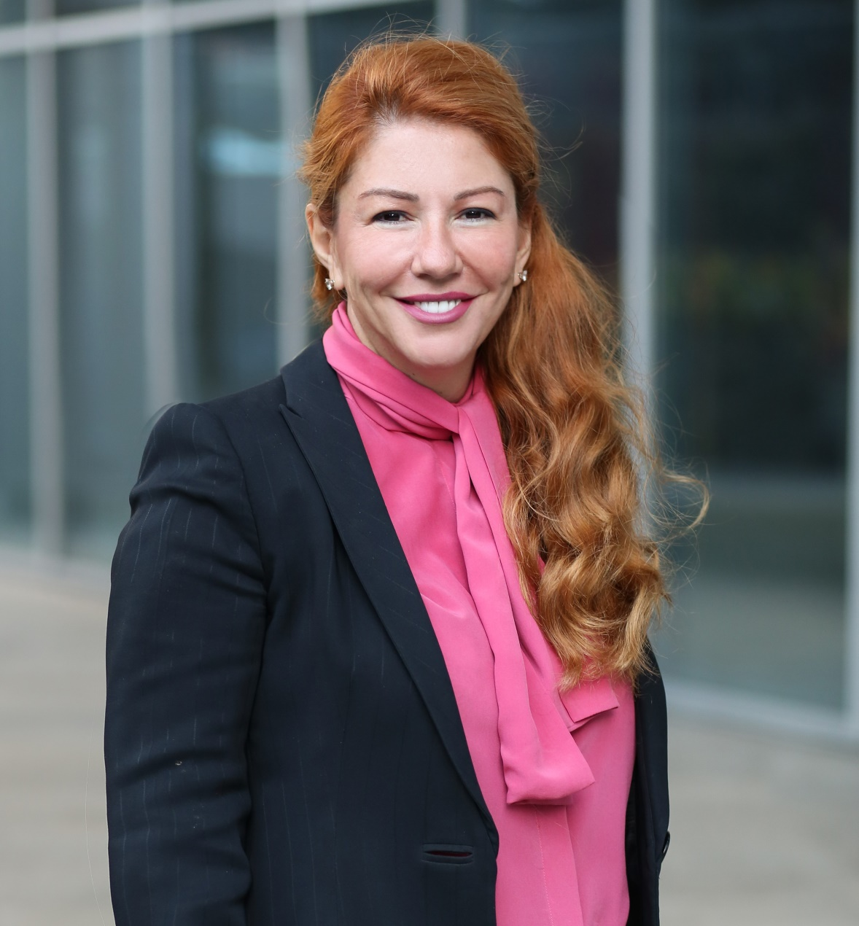
Ahu Buyukkusoglu Serter-Council Member
India-Turkey Business Council WICCI
Ahu Buyukkusoglu Serter is a serial entrepreneur and investor. Empowered by her multipotentiality, as the second-generation business leader, she cultivated a dual transformation approach by encouraging new business lines, incentivizing intrapreneurship, and establishing a corporate venture capital arm. She is the founder of Fark Labs, a global innovation and transformation hub, Arya Women Investment Platform and F+Ventures. Ahu founded Turkey's first gender-lens impact investment fund, the Arya Venture Capital Investment Fund, in 2022. She is also the President of Fark Holding, a 50-year-old family-business specializing in automotive and white-goods sectors. Guided by her vision, Fark Holding was named one of the 20 most innovative companies in Turkey by Forbes.
She currently serves on the boards of Sisecam, TTGV (Technology Development Foundation of Turkiye), TAYSAD (Automotive Suppliers Association of Turkiye) and TAIDER (Family Business Association, an affiliate of Family Business Network), where she leads innovation initiatives

Slide 8
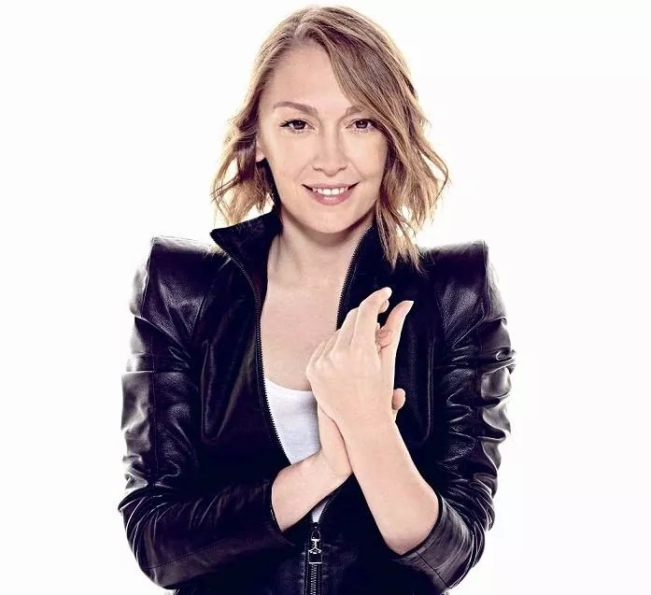
Arzu Kaprol-Council Member
India-Turkey Business Council WICCI
Arzu Kaprol, Turkish fashion designer. Graduated from Mimar Sinan University, Textile and Fashion Design in 1992. Continued her couture education in Paris American Acedemy in 1994-95.
In 1995 with the prestigious “Avant-Garde Designer” award from Beymen Academia founded her design studio at the age of 21.
She took active role during the growth of NetWork – Beymen Group of companies. https://www.network.com.tr where she was the creative director from 2002 till 2012. Where she also created QUE, a totally unique and fresh design brand. http://que.com.tr/tr/koleksiyon.html
She participated and performed her Designer brand shows at the official calendar in Paris Fashion Week, from 2011 till 2015 and opened her showroom on Rue Saint Honore .With international presence after Paris Fashion Week appearances, spread its sales network in iconic stores like Harrods in London, Montaigne Market in Paris, Bergdorf Goodman in New York.

Slide 9
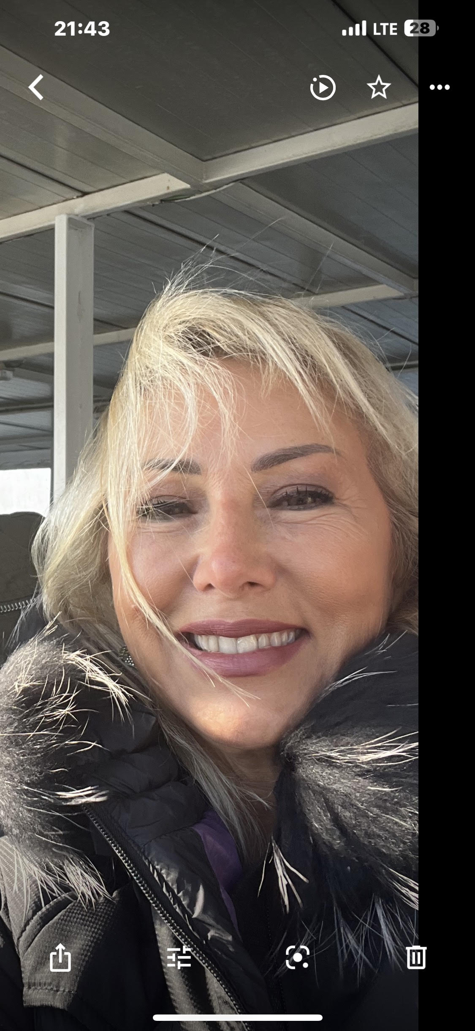
Jale Barahya-Council Member
India-Turkey Business Council WICCI
Jale Barahya graduated from Mimar Sinan University, Department of Interior Architecture in 1983 and completed her Masters from the Faculty of Architecture in 1989.
Jale is the founder of ARTA, interior design,and production house, Istanbul since 1989.

Slide 10
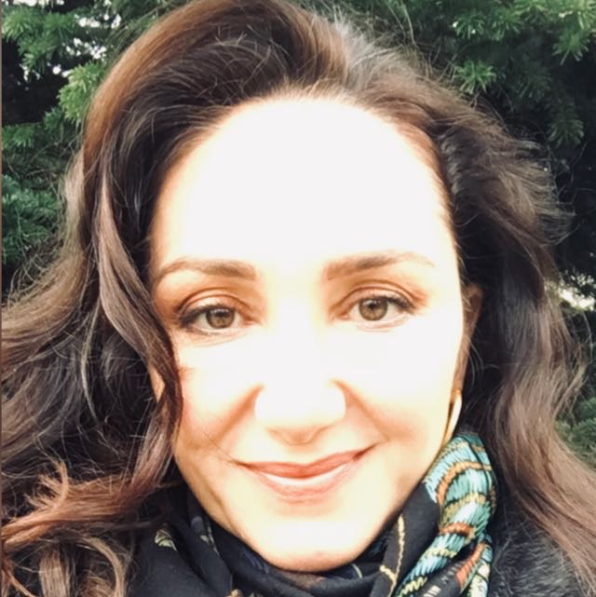
Elif Eminoglu-Council Member
India-Turkey Business Council WICCI
Dr Elif Eminoglu graduated from Istanbul University, Istanbul Faculty of Medicine in 1993. After completing her compulsory service, she received her specialization in 2002 from Istanbul University Cerrahpasa Faculty of Medicine, Department of Anesthesiology, Reanimation and Intensive Care. While working as a doctor in the anesthesia department of the private Kadikoy Sifa hospital in 2002,she completed the hospital management certification program at Marmara University in 2003. She took an active role in the board of Atasehir Sifa Hospital, the second hospital of the Kadıköy Sifa Group in 2010. She worked at Kadıköy Sifa Hospital for 15 years. She has been working in the anesthesia department of Ataşehir Florence Nightingale Hospital since 2017.
Due to her interest in Chinese medicine, she received the Medipol University Acupuncture Certification Program in 2018.
During her professional experience, she realized that her education was ‘’focused on disease’’, and she made a personal effort to make her medicine ‘’health-oriented’’.

Slide 11
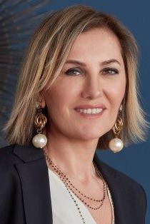
Ayşe Yağcı Büyükpınar-Council Member
India-Turkey Business Council WICCI
Ayşe Yağcı Büyükpınar was the Founding Partner and General Manager of Jules Verne Business Mice Travel in 1998 and continued her duty until 2004. As of 2004, Jules Verne Business Mice Travel joined Zorlu Group under the leadership of Ayşe Yağcı Büyükpınar.
Ayşe has worked in different areas of the tourism sector for many years. She continues her experiences in both "Organization" and "Travel Management" at Jules Verne Business Mice Travel
In addition, Ayşe has written articles about tourism and travel experiences for Newspapers and Magazines for many years.
Detailed process-oriented working principles, following innovations, creating a good team, approaching events as a holistic, feeding creativity are always at the top of Ayşe's agenda.

Slide 12
Gaye Cevikel-Council Member
India-Turkey Business Council WICCI
Dynamic Turkish businesswoman Gaye Cevikel introduced contemporary design to her native country, fostered the nation’s design market and founded the first Turkish-based international luxury design company, GAIA&GINO. She established GAIA&GINO (a combination of her nickname, Gaia, and the name of her golden retriever, Gino) in 2004. GAIA&GINO infuses handcrafts with contemporary sensibility by asking design luminaries such as Karim Rashid, Arik Levy, Andree Putman, Jaime Hayon, Constantin Boym, Christian Ghion, Harry Allen, Sebastian Bergne, Defne Koz Nendo, David Adjaye, Yves Behar, Noe Duchaufour Lawrence, Annette Hinterwirth, Brad Ascalon, Pearson Lloyd, Juergen Mayer and Christian Haas to design innovative, witty and story telling products which typify the brand’s identity. She acts as the creative director of GAIA&GINO and deeply involved in the design direction and management , product development and strategic marketing of the brand.
In 1996 Cevikel founded Decorum in Istanbul, the first store in Turkey to offer contemporary design. More than just a store, Deoorum also played an educational role, fostering the development of a contemporary design consciousness in the Turkish market.

Slide 13
Yıldız Bozkurt Özcan-Council Member
India-Turkey Business Council WICCI
Yıldız Bozkurt Özcan, who graduated from Boğaziçi University, Faculty of Economics and Administrative Sciences, Department of Business Administration with an honor degree, first started her career at Akbank, while continuing her career, she also completed the Banking Master's Program at Marmara University.
Later, while continuing her professional career in Corporate Banking at Abn-Amro, she applied to the graduate scholarship program sponsored by the British Government. She won this scholarship and went to England to pursue an academic career. She received her master’s degree in International Banking and Finance at Southampton University. After completing her master's program, she received a scholarship from City University London and continued her doctoral program, but she decided to quit her academic life and returned to Turkey. Returning to her banking career, she worked as Branch Manager at Interbank and later moved to Akbank Head Office as Group Manager to establish the Commercial Banking Department and was later appointed as the Department Head. Then she moved to ABN AMRO Bank again as an Executive Vice President to set up commercial banking department.

Slide 14
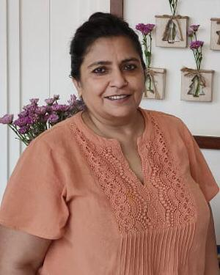
Devinder Anand-Council Member
India-Turkey Business Council WICCI
Devinder Anand, 53, living in Goa, India. After having dabbled in business for several years, I have moved on to Psycho- Spiritual Coaching adding the element of energy to it. I know this to be a calling, as the satisfaction I derive in seeing the shift in people is unparalleled. Over the years, I have mastered the art of transformation in people and places. The result is a while lot of happier, healthier, emotionally balanced people scaling heights professionally and personally.

Slide 15
SUPPORTED BY
WICCI is supported by the massive global networks of ALL Ladies League (ALL), Women Economic Forum (WEF), and SHEconomy.
ALL is a movement of ‘Sisters Beyond Borders.’
WEF is a platform for ‘Business Beyond Borders.’ SHEconomy is e-commerce for women worldwide in Goods & Services for ‘Commerce Beyond Borders’

Slide 16
COUNTRIES REPRESENTED
Albania, Angola, Armenia, Argentina, Australia, Azerbaijan, Bangladesh, Brazil, Burundi, Cameroon, Canada, Chad, China, Costa Rica, Croatia, Cyprus, Czech Republic, Colombia, Ecuador, Egypt, Ghana, Germany, Greece, Guatemala, Hong Kong, Hungary, India, Italy, Israel, Ireland, Japan, Kazakhstan, Kenya, Kyrgyzstan, Lesotho, Luxembourg, Malawi, Malaysia, Mexico, Moldova, Monaco, Montenegro, Morocco, Mozambique, Malta, Netherlands, Nigeria, Nepal, New Zealand, North Macedonia, Norway, Paraguay, Portugal, Peru, Puerto Rico, Philippines, Qatar, Romania, Russia, Rwanda, Serbia, Singapore, Slovenia, Spain, South Africa, South Korea, Suriname, Sweden, Switzerland, Syria, Tunisia, Turkey, Uganda, Ukraine, UK, Uruguay, Venezuela, Vietnam, Virgin Islands (US), UAE, USA, Uzbekistan, Zimbabwe.

Slide 17
WOMEN'S INDIAN CHAMBER OF COMMERCE ANDINDUSTRY

